Slide 1

The Regional Demographic Influences Motivating Cyberbullying in Urban Centers Across Canada| Research Proposal
Presented by: Simon Miller as part of the University of Essex Computing Department
Advisor: Stephanie Paladini

Slide 2

Contributions to the Field | The Current Research Gap
A literature review was conducted to assess current state of study into cyberbullying
Trends that were highlighted throughout:
The current body of literature looks at cyberbullying through the lens of one region through the lens of incident detection or localized prevention efforts
Emphasis on detection and machine learning approaches or
Missed opportunity to look into different how people experience cyberbullying in different locations, be it Ecuador or Japan, or Ontario or Alberta
Limited in scope, and results are often only valid under specific, controlled circumstances

Slide 3
Literature Review:
21 Articles were sampled from academic sources such as Scopus, IEEE and ResearchGate.
Topics included analysis of cyberbullying and the application of machine learning algorithms in the detection or prevention of cyberbullying
The objective of the review was to attempt to answer two primary research questions:
RQ1: What is the efficacy of applying machine learning principles to the detection of cyberbullying across social media communities?
RQ2: How does the cybersecurity research community address cyberbullying as a universal phenomenon, distinguished by a diversity of languages, cultures and political ideologies?

Slide 4
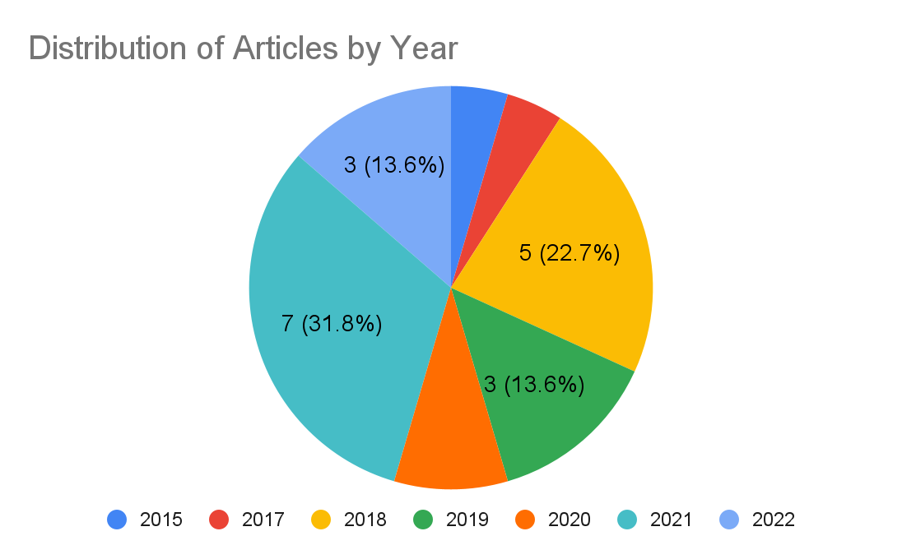
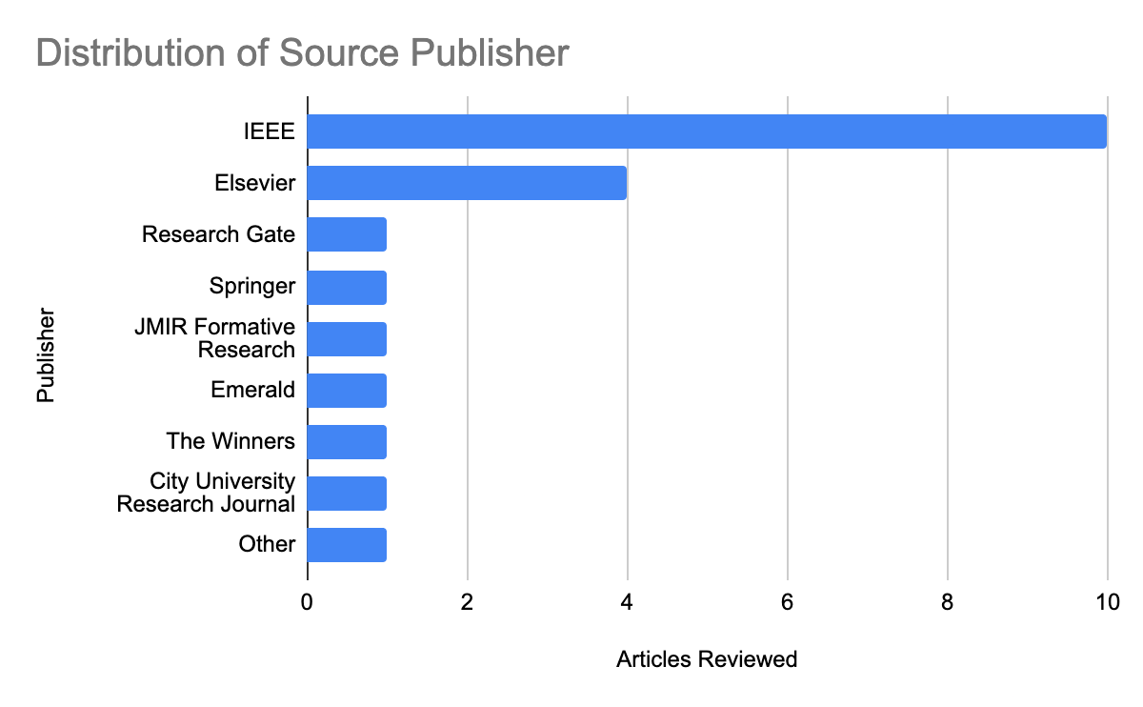
Distribution of Sources

Slide 5
Research Question:
RQ: What effect do culturally distinct Canadian locales have on how individuals perceived motivations of cyberbullying?

Slide 6
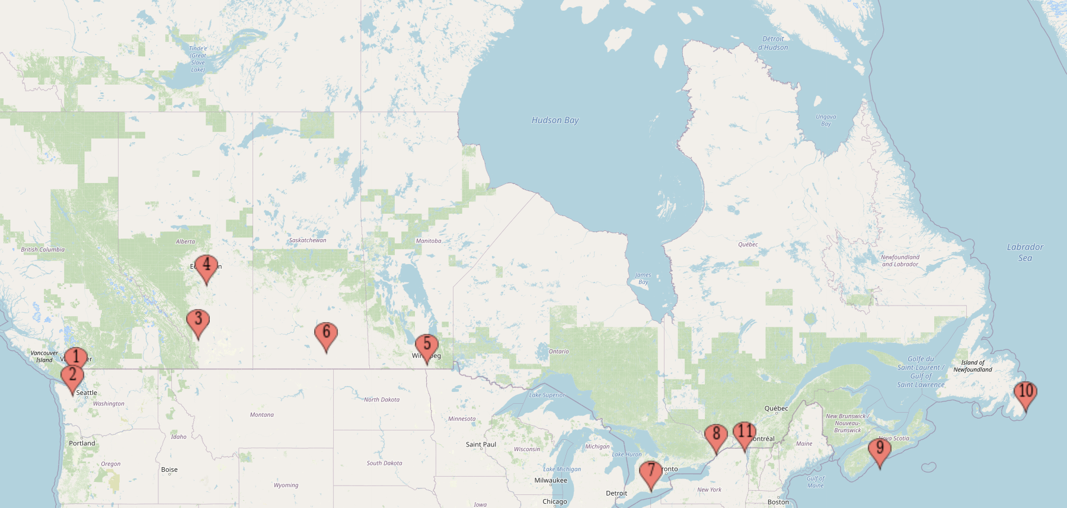
Methodology | Locations of Interest

Slide 7
Methodology | Survey Design
Data Collection:
Develop a survey using a survey generator such as Qualtrics or Surveymonkey.
Number of questions should be limited to a maximum of 10 since we’re having people volunteer their time and we want to maximize response rate

Slide 8

Methodology | Survey Design
Due to the format of the questions and what is being asked, the data produced will be largely qualitative with numeric description meaning the outcome will be presented numerically the data type is still qualitative
Surveys will be distributed via social media platforms such as Facebook or Instagram since they offer very affordable, concise targeting that allows us to target our audience by location, age, sex

Slide 9
Survey Questions
Sample Questions:
Where is your permanent residence?
Have you been a victim of cyberbullying in the last year
Would you say your experiences were motivated by:
Sexuality
Race
Personal
Spiritual Belief
Politics
Other

Slide 10
Data Analysis
The data collected will provide key insights into the demographics of cyberbullying across Canada
Responses are largely Boolean with
Yes = 1
No = 0
Blank = Null which is represented as a 0
Datatype does not lend to correlation analysis, though future study would see value in data analysis where it fits.

Slide 11
Data Analysis
Data can be best represented and discussed graphically
Largely Pie and Bar chart
Key Points:
Relationship between age, sex, race or beliefs and experiences with cyberbullying
Assessment compared between cities
Aggregate analysis to provide insight into cyberbullying across Canada

Slide 12
Risks and Ethics
Risks are relatively minor since no personally identifiable information will be collected
Survey is completely anonymous and voluntary
Survey targets those above 18 and any submissions with an age below 17 can be removed from the dataset

Slide 13
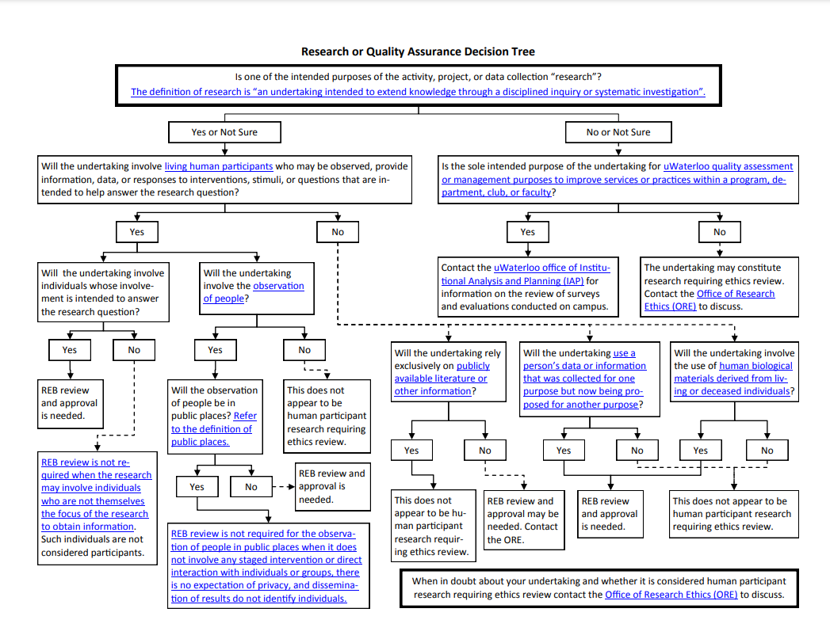
Ethical Considerations
(University of Waterloo, 2014)

Slide 14
Artifacts and Outcomes
Because this project does not generate a piece of software, or produce any code the artifacts in this case is the survey data and the survey itself

Slide 15
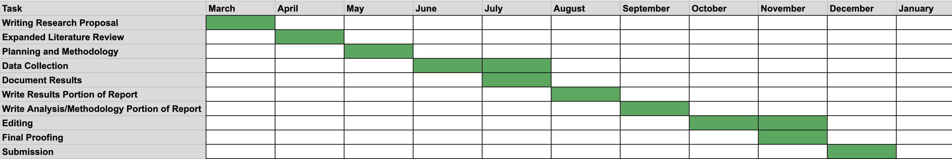
Timeline Estimates

Slide 16
Thank You!

Slide 17
References:
Koggalahewa, D., Xu, Y. and Foo, E. (2022). An unsupervised method for social network spammer detection based on user information interests. Journal of Big Data, 9(1). Available at: https://journalofbigdata.springeropen.com/track/pdf/10.1186/s40537-021-00552-5.pdf [Accessed 14 Mar. 2022].
Kramer, L. (2021). How to Write a Research Proposal. [online] How to Write a Research Proposal | Guide with Examples. Available at: https://www.grammarly.com/blog/how-to-write-a-research-proposal/ [Accessed 27 Mar. 2022].
University of Waterloo (2014). Does my data collection activity require ethics review? uwaterloo.ca. Available at: https://uwaterloo.ca/research/office-research-ethics/research-human-participants/pre-submission-and-training/human-research-guidelines-and-policies-alphabetical-list/does-my-data-collection-activity-require-ethics-review [Accessed 25 Mar. 2022].
Yokotani, K. and Takano, M. (2022). Predicting cyber offenders and victims and their offense and damage time from routine chat times and online social network activities. Computers in Human Behavior, [online] 128, p.107099. Available at: https://www.sciencedirect.com/science/article/abs/pii/S0747563221004222 [Accessed 27 Feb. 2022].

